Slide 1
Unified Mentor – Machine Learning Internship Project
Fraud transaction detection using machine learning algorithms
Indumathi Rajendran

Slide 2
agenda
Introduction
Dataset Overview
Exploratory Data Analysis (EDA)
Data Preprocessing
Model Building
Evaluation Metrics
Model Deployment
Conclusion

Slide 3
INTRODUCTION
Fraudulent financial transactions pose a significant threat to both businesses and customers in the digital economy. With the rapid growth of online banking and electronic payments, detecting and preventing fraud has become more crucial than ever. This project aims to develop a machine learning-based solution to accurately classify transactions as fraudulent or legitimate using historical transaction data. The ultimate goal is to build a reliable, scalable system that can not only detect fraud but also be deployed via an API with a user-friendly web interface for real-time use.

Slide 4
objective
The primary objective of this project is to build an efficient and accurate fraud detection system using machine learning techniques. The goal is to analyze historical credit card transaction data, identify patterns associated with fraudulent behavior, and train a predictive model capable of detecting such activities in future transactions. Additionally, the project aims to handle challenges like extreme class imbalance and ensure high recall to minimize false negatives. Beyond model development, the objective also includes deploying the solution through a Flask-based API and creating an intuitive HTML/CSS frontend interface to allow users to interact with the system seamlessly.

Slide 5
Dataset overview
Dataset used: Credit Card Fraud Detection dataset (commonly from Kaggle).
Contains anonymized features (V1–V28) resulting from PCA transformation, along with Time, Amount, and Class.
Highly imbalanced: fraud transactions represent less than 0.2% of the data.
Class = 1 → Fraud, Class = 0 → Non-fraud.

Slide 6
Data preprocessing
Standardized features like Amount using StandardScaler.
Dropped or retained Time depending on correlation/impact.
Addressed class imbalance using:
Undersampling the majority class
SMOTE (Synthetic Minority Oversampling Technique)
Split data into training and testing sets (typically 70-30 or 80-20).

Slide 7
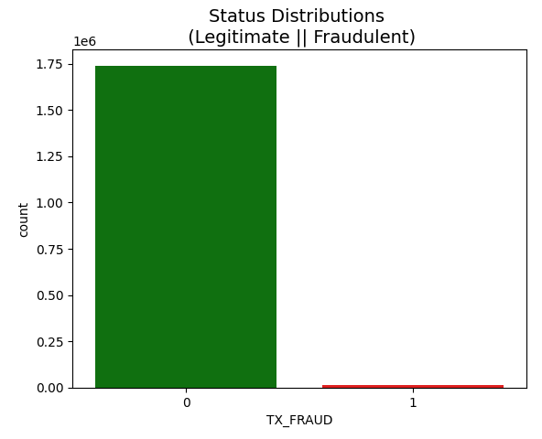
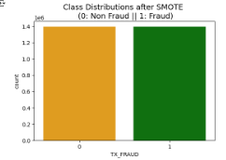
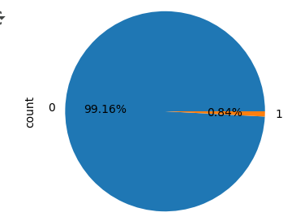
Eda analysis – class distribution

Slide 8
Exploratory data analysis
Analyzed distribution of transaction amounts and time across fraud and non-fraud classes.
Visualized class imbalance using pie/bar charts.
Used correlation matrix to identify feature relationships.
Highlighted differences in feature distributions for fraudulent vs. legitimate transactions.

Slide 9
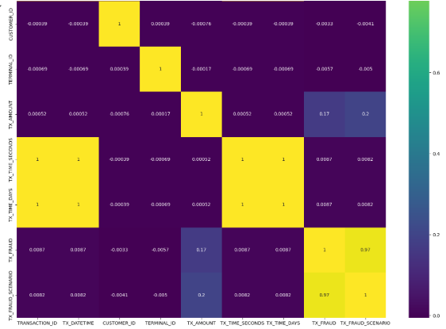
EDA – Feature correlation

Slide 10
Model building
To build an effective fraud detection system, we experimented with several machine learning models, focusing on performance and interpretability. The dataset, being highly imbalanced, required careful selection of algorithms and evaluation metrics. We started with Logistic Regression as a baseline classifier due to its simplicity and interpretability. We then implemented Random Forest, an ensemble learning method that improves accuracy by aggregating multiple decision trees. The models were trained on preprocessed data with features scaled appropriately and class imbalance addressed using techniques like undersampling.

Slide 11
Evaluation metrics
Given the severe class imbalance in the dataset—with fraudulent transactions comprising a very small fraction of total transactions—traditional accuracy is not a reliable metric for evaluating model performance. Therefore, we focused on more appropriate metrics such as Precision, Recall, and F1-score. Recall was prioritized, as missing a fraudulent transaction (false negative) can be more costly than flagging a legitimate one (false positive). Additionally, the ROC Curve and AUC (Area Under Curve) were used to evaluate the model's ability to distinguish between classes across different thresholds, with high er AUC values indicating better discrimination capability.

Slide 12
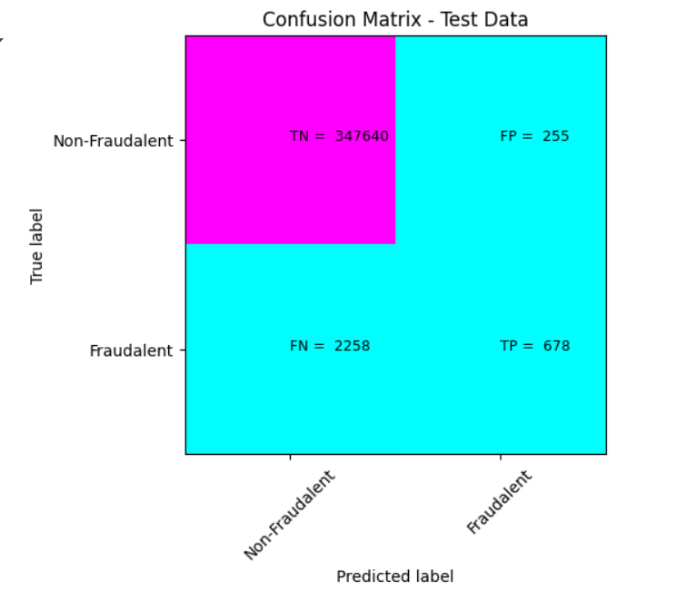
XGBOOST classifier - Confusion MATRIx

Slide 13
Model comparison
Multiple machine learning models were trained and evaluated to determine the most effective algorithm for fraud detection. Logistic Regression provided a strong baseline with good interpretability but showed limitations in capturing complex patterns. In contrast, the Random Forest Classifier significantly outperformed the baseline, offering higher recall and F1-score, which are crucial for detecting rare fraud cases. While both models achieved high AUC scores, Random Forest demonstrated better generalization and robustness to noise, thanks to its ensemble nature. The final selection was based not only on performance metrics but also on model consistency across different validation sets, making Random Forest the preferred choice for deployment.

Slide 14
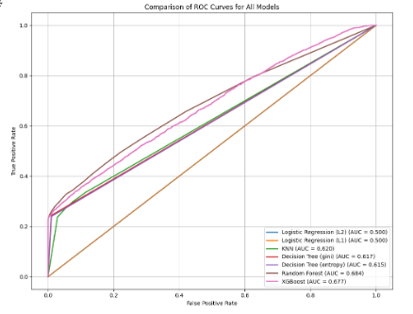
Comparison of models – roc curve

Slide 15
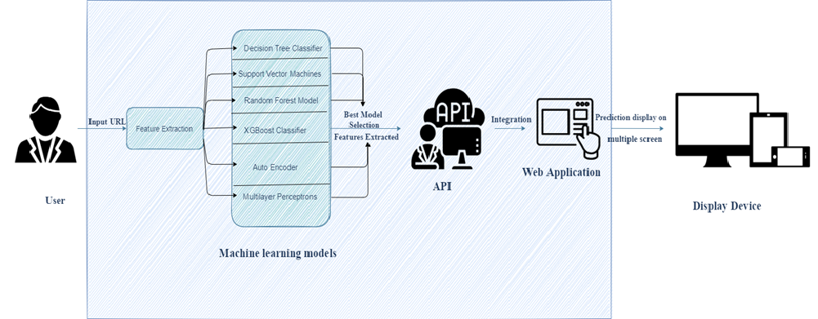
Architectural Design and Deployment
The trained model was integrated into a Flask web framework for deployment. The model was serialized using joblib and loaded into a Flask API endpoint. A simple HTML/CSS frontend was created to accept user inputs, which are sent to the backend via HTTP POST requests. The Flask server processes the inputs, applies the model, and returns the predicted price to the user through the interface.

Slide 16
Model deployment
To make the fraud detection model accessible for real-world use, we deployed it using a Flask-based API. The trained Random Forest model was serialized using joblib and loaded into the Flask backend, which exposes a RESTful endpoint to accept transaction input data in real-time. When a user submits data via the frontend, the Flask API processes the request, applies the same preprocessing steps used during model training, and returns a prediction indicating whether the transaction is fraudulent or legitimate
In addition to the backend, developed a simple yet user-friendly HTML/CSS frontend interface. This interface allows users to manually input transaction feature values (such as amount, time, and PCA components) through a web form. Upon submission, the data is sent to the Flask API, and the result—fraud or non-fraud—is displayed instantly. This interactive interface not only demonstrates the end-to-end workflow of the project but also provides an intuitive way to test and validate the model.

Slide 17
DESIGN OF WEB APPLICATION
Web Application Development
Designed a user-friendly, browser-compatible web UI
Enabled input & prediction display
Built using HTML, CSS, JavaScript (or React)
2. Model Integration
Integrated final model into the backend (Flask/Django)
Connected model predictions to the frontend
Ensured real-time detection functionality
3. Deployment & Testing
Deployed web app to a live server
Tested for performance & user feedback
Ensured system stability and speed

Slide 18
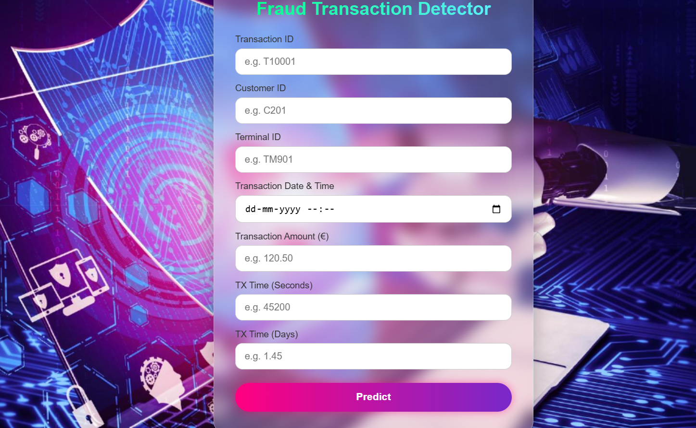
Fraud transaction detector

Slide 19
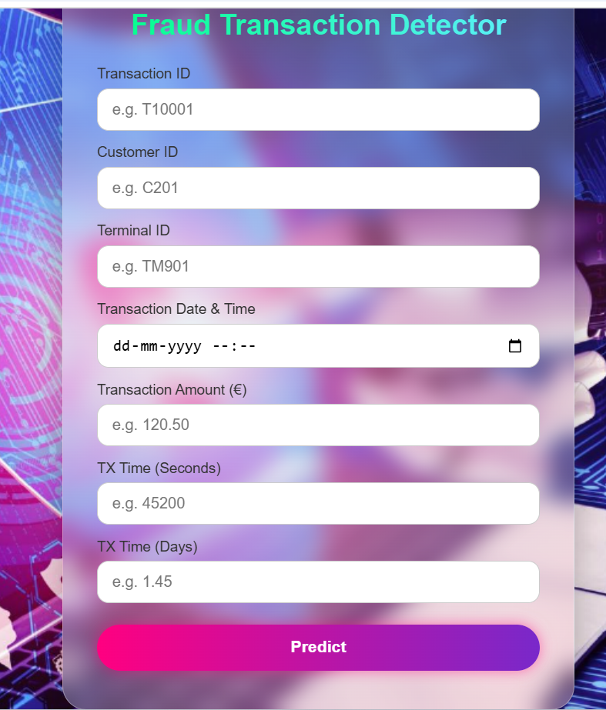
Fraud transaction detector

Slide 20
conclusion
This project demonstrates the successful development of a machine learning-based system for detecting fraudulent transactions with a strong focus on precision and recall. Key challenges, such as severe class imbalance and the need for reliable evaluation metrics, were effectively addressed through careful model selection and performance tuning. Among the models tested, the Random Forest classifier showed superior performance and was chosen for deployment. The solution was deployed using a Flask API, integrated with an HTML/CSS frontend for user interaction.

Slide 21
Thank you

